Slide 1
Unit Testing in Legacy Code
Daniel Errington

Slide 2
What’s the problem with testing legacy code?
Legacy code often doesn’t follow modern design patterns which allow for unit testing
This means that it is often tightly bound to the UI, external services, or the database (or all three!)
Unit tests shouldn’t interact with any of these, that’s the domain of other test types

Slide 3
So why bother?
Unit testing gives us confidence that when we refactor code we haven’t broken the existing functionality
Without it we can easily introduce bugs, each of which wastes multiple man-hours
With it we can use methodologies like TDD to simplify writing new features
Most importantly it gives us the confidence to refactor legacy code into regular code
Which ultimately lets us refactor the unit tests to be simpler and more effective

Slide 4
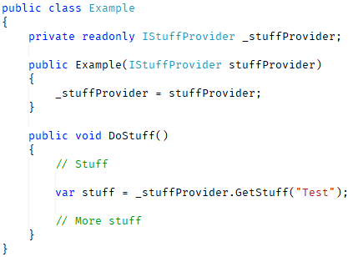
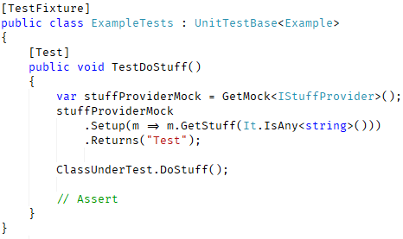
Unit testing regular code
In regular code we would expect patterns like Inversion of Control (IoC) which let us supply dependencies to functions
This lets us provide mocks of types which we’re fully in control of
Which in turn allows us to finely control the values going into the function and record the values coming out
We use common testing tools like Moq to mock objects and pass them in with Dependency Injection frameworks

Slide 5
Tools available in legacy code
Internal method calling & internal field setting
Allow us to set variables we wouldn’t normally have access to
The aim being to force our own implementations into the object
Override methods
Allows us to replace methods in classes which can be inherited
Often requires changing the code of the called classes and potentially exposes things which should remain internal
Method replacement
Allows us to replace methods on objects which we can’t otherwise replace
A brute force method to allow us to inject our own implementations

Slide 6
Using reflection
Reflection allows us to access the inner workings of a class
Even private and read-only items can be accessed
The ReflectionHelper class provides wrappers around reflection to do common tasks

Slide 7
ReflectionHelper.SetPrivateField
void SetPrivateField<TTarget>( string fieldName, TTarget setOn, object value)
Allows us to set internal fields in a class (but not properties)
TTarget is the class that the field belongs to
fieldName is the name of the field to set
setOn is the object to set the value on. If this is a static field then pass null
value is the value to set the field to

Slide 8
ReflectionHelper.InvokePrivateMethod
object InvokePrivateMethod<TTarget>( string methodName, TTarget invokeOn, params object[] parameters)
Allows us to call private methods on a class
methodName is the name of the method to call
invokeOn is the object to invoke the method on. If this is a static method then pass null
Parameters are the parameters to pass to the function.

Slide 9
Getting or setting auto-properties with reflection
Auto-properties do have backing fields
<property-name>k__BackingField
However, it’s easier to remember that properties are also methods
get_PropertyName and set_PropertyName
If there is no getter/setter then use the backing field. Otherwise, use the method.

Slide 10
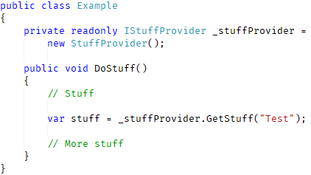
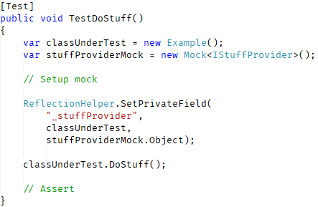
When to use reflection
In this example we would want to replace _stuffProvider with our own implementation
Fortunately, it’s an interface so we can use Moq to create a mock
It’s not injected in so how do we set it?
ReflectionHelper.SetPrivateField

Slide 11
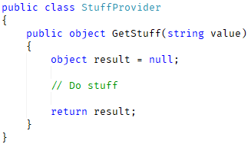
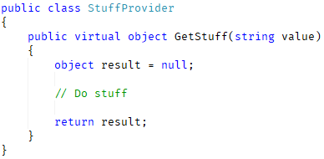
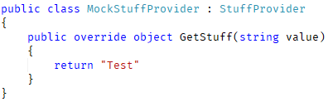
Overriding methods
In the previous example the field _stuffProvider referenced an interface. But what if it hadn’t?
We can still access the field and change it but need a way of overriding the methods without a mocking tool.
Make the method virtual!

Slide 12
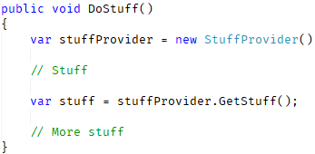
Method replacement
So, what do we do when reflection isn’t enough?
Take this example:
We can’t modify the value of stuffProvider with reflection so what can we do to stop the real GetStuff from being called?
Overwrite it with our own method!

Slide 13
MethodReplacer
The MethodReplacer.ReplaceMethod method allows us to replace some methods with our own code.
Once replaced, every call to this method on any instance of an object will call our code.
There are some restrictions:
It can’t replace constructors on objects
It can’t replace methods on Form objects
It can’t replace methods in the same class that they’re called from
Once a method has been replaced it can’t be replaced again or reinstated
This function is powerful but could also lead to complicated setup if used too much.
Only use when you absolutely have to!

Slide 14



MethodReplacer.ReplaceMethod
There are too many overloads to go into detail for each one but here are some basic scenarios:
Replace instance method:
Replace static method:
Replace property or private method:
Parameters specified by Parameter class
Parameters specified by type

Slide 15
What NOT to do
DON’T make huge changes to the code to introduce unit tests
The bigger the change you make the more likely it will introduce bugs
Best if you don’t make any changes at all
DON’T run the tests before you’re sure that you can prevent them from calling external services or writing to a data store
Especially if this could affect production systems!
DON’T not test the code (Yes a double negative…hush…)
Testing is all that gives us the confidence to change code
DON’T use the methods we’ve talked about unless you absolutely have to
Powerful though they are, they are not the way things should be done
If at all possible, use mocking libraries like Moq combined with patterns like inversion of control

Slide 16
What TO do
DO make small, easy to reason about, changes to enable unit testing
If you can convert a field to use an interface instead of using method replacement, do so
DO write integration tests if possible when a unit test can’t be written without method replacement
These integration tests still shouldn’t interact with the database, external services, or the UI
DO identify all of the inputs and outputs of the method before writing tests
This helps prevent you missing something you should be mocking
Also helps you find all the values you should be testing
DO write unit tests for any new code
Remember that we’re not just trying to test the old stuff, we want to be sure the new stuff is covered too

Slide 17
IMPORTANT
These tests are not meant to be the final, lasting tests
They are a scaffold to allow the refactoring of the code to use proper testing patterns

Slide 18
Questions?

Slide 19
A challenge
https://github.com/awsxdr/legacytestingexample
Clone the master branch of this repo and have a look at it
Try to add comprehensive tests for the FlightFinder.FindFlights function
This should use all the tools we’ve covered
Remember:
Work out what the function is trying to do first
Any changes to the code should be small and you should have a very high degree of confidence that they won’t introduce bugs
Method replacement is powerful but should only be used as a last resort
We’ll get back together in a bit and compare solutions!

